Slide 1
A
Personal
Educational
eXperience

Slide 2
What interests you?
What concerns you?
What fascinates you?
What excites you?
What inspires you?

Slide 3
Art
Science
Technology
Space
History
Architecture
Music
Sports

Slide 4
-Ask a FAT question…
-Your project can NOT be about something you already know

Slide 5
Space
What forms of space travel are possible?
What causes a black hole?
What evidence is there that there was or is life on other planets?

Slide 6
Music
What are the influences of rock and roll music?
Why do some groups stay popular for many years and some bands only have one hit?
What is required to become a contestant on American Idol?

Slide 7
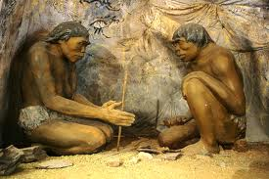
History
What was life like in the Ice Age?
Which animals that are alive today most closely resemble dinosaurs?
How did World War II effect today’s world?

Slide 8
Science
How do broken bones heal?
Why do earthquakes happen?
Which type of light is best for plants?

Slide 9
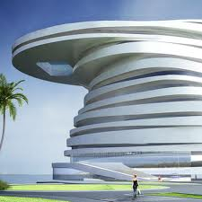
Architecture
Where do we see evidence of Roman architecture?
Who designed the funny looking house on Lookout Mountain, and why?
Who was Frank Lloyd Wright and what famous buildings did he design?

Slide 10
Technology
How are robots used?
How are apps made?
How was the internet invented?

Slide 11
Art
What is considered modern art?
How was Van Gogh influenced by other artists?
Where can you go to see the worlds most famous pieces of art?

Slide 12
Sports
What is required to become professional sports announcer?
What does it take to create a new game?
How are new stadiums designed?

Slide 13
What else???

Slide 14
How will you research?
Books
Magazines
Interview an expert
DVDs
Survey
Internet

Slide 15
How will you present?
Multi-media (PowerPoint, Prezi, Glog)
Demonstration
Model
Diorama
Movie
Web page
eBook
Display board
Be creative

Slide 16
Steps to consider…
FAT question
Proposal
Research
Bibliography
Draft
Final presentation
WOW factor

Slide 17
-A lot of the work will be done at home
-There may be opportunities to get help at school, watch and listen for information
- Talk to your teacher if you have questions or need some specific help

Slide 18
Have Fun!

Slide 19
Learn a lot!

Slide 20
Amaze Us with your brilliance!

